Slide 1

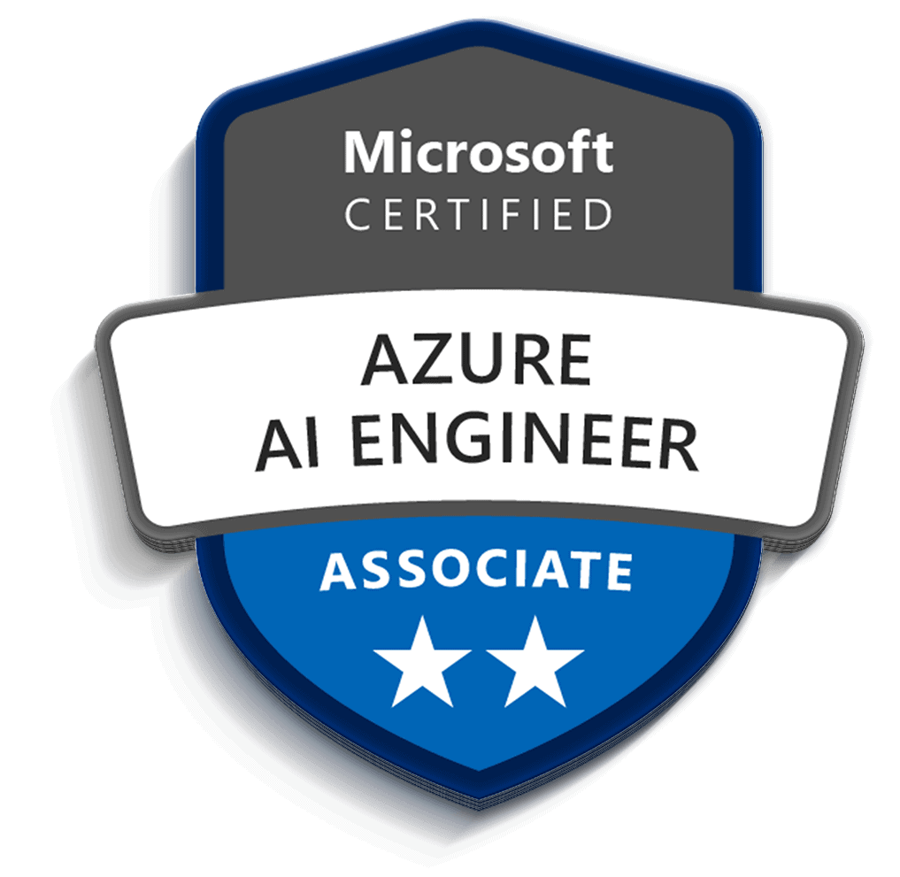
COURSE SLIDES
Microsoft Certified Azure AI Engineer Associate AI-102 Training
TGS Ref No: TGS-2023036651
TSC: Artificial Intelligence Application in Product Development (ICT-TEM-4034-1.1)
Conducted by Tertiary Infotech Academy Pte Ltd | UEN 201200696W
Version 1.0 | 13 Jul 2026
Microsoft Certified Azure AI Engineer Associate AI-102 Training | TGS-2023036651
Copyright 2026 Tertiary Infotech Academy Pte Ltd. All rights reserved.

Slide 2
COURSE ADMINISTRATION
Welcome and Housekeeping
Microsoft Certified Azure AI Engineer Associate AI-102 Training | TGS-2023036651
Copyright 2026 Tertiary Infotech Academy Pte Ltd. All rights reserved.
2

Slide 3
TRAQOM / SSG
Digital Attendance (Mandatory)
Take AM, PM and Assessment digital attendance for WSQ-funded courses.
Scan the SSG portal QR code shown by the trainer or administrator.
Minimum 75% attendance is required for funding and assessment eligibility.
Microsoft Certified Azure AI Engineer Associate AI-102 Training | TGS-2023036651
Copyright 2026 Tertiary Infotech Academy Pte Ltd. All rights reserved.
3

Slide 4
YOUR TRAINER
About the Trainer
ROLE
Principal Trainer, Tertiary Infotech Academy Pte. Ltd.
AA
QUALIFICATIONS
PhD - specialises in AI, automation and software engineering.
Dr. Alfred Ang
DELIVERS
WSQ courses on AI agents, automation (n8n) and app development.
Principal Trainer Tertiary Infotech Academy Pte. Ltd.
FOUNDER
Founder and lead instructor at Tertiary Infotech / Tertiary Courses.
Microsoft Certified Azure AI Engineer Associate AI-102 Training | TGS-2023036651
Copyright 2026 Tertiary Infotech Academy Pte Ltd. All rights reserved.
4

Slide 5
YOUR TRAINER - GENERAL
About the Trainer
NAME
?
TITLE / DESIGNATION
QUALIFICATIONS
Your Trainer
AREAS OF EXPERTISE
General Trainer template - to be completed by the trainer
TRAINING & INDUSTRY EXPERIENCE
CONTACT
Microsoft Certified Azure AI Engineer Associate AI-102 Training | TGS-2023036651
Copyright 2026 Tertiary Infotech Academy Pte Ltd. All rights reserved.
5

Slide 6
ICE-BREAKER
Let's Know Each Other
Your name and organisation or role.
Your experience with Azure or AI services.
Your goal for this AI-102 course.
Microsoft Certified Azure AI Engineer Associate AI-102 Training | TGS-2023036651
Copyright 2026 Tertiary Infotech Academy Pte Ltd. All rights reserved.
6

Slide 7
HOUSEKEEPING
Ground Rules
1
Set your mobile phone to silent mode.
2
Participate actively - no question is too small.
3
Mutual respect: agree to disagree.
4
One conversation at a time.
5
Be punctual; return from breaks on time.
6
75% attendance is required.
Microsoft Certified Azure AI Engineer Associate AI-102 Training | TGS-2023036651
Copyright 2026 Tertiary Infotech Academy Pte Ltd. All rights reserved.
7

Slide 8
SCHEDULE
Lesson Plan - 2 Days
Day 1
Day 2
Planning, security, monitoring, responsible AI.
Generative AI, Foundry, Azure OpenAI, RAG.
Agentic AI and Foundry Agent Service.
Vision, video, NLP, speech, translation.
Custom language and question answering.
Azure AI Search, knowledge mining, vector search.
Document Intelligence and Content Understanding.
Capstone review and final assessment.
Microsoft Certified Azure AI Engineer Associate AI-102 Training | TGS-2023036651
Copyright 2026 Tertiary Infotech Academy Pte Ltd. All rights reserved.
8

Slide 9
WSQ ALIGNMENT
Skills Framework
TSC Title: Artificial Intelligence Application in Product Development.
TSC Code: ICT-TEM-4034-1.1.
Abilities: analyse algorithms, evaluate AI applications, assess feasibility and improvements.
Knowledge: AI applications, performance analysis, evaluation methods, algorithm design and implementation.
Microsoft Certified Azure AI Engineer Associate AI-102 Training | TGS-2023036651
Copyright 2026 Tertiary Infotech Academy Pte Ltd. All rights reserved.
9

Slide 10
WHAT YOU WILL ACHIEVE
Learning Outcomes
Analyse Azure AI applications and establish their correlation with efficiency.
Identify and evaluate strengths and limitations of Microsoft Azure AI applications.
Assess feasibility and improvements when applying Azure AI to product and maintenance processes.
Microsoft Certified Azure AI Engineer Associate AI-102 Training | TGS-2023036651
Copyright 2026 Tertiary Infotech Academy Pte Ltd. All rights reserved.
10

Slide 11
LAB-ALIGNED FLOW
Course Outline
Lab 01: Plan, Manage, Monitor, and Secure an Azure AI Solution
Lab 02: Responsible AI, Content Safety, Governance
Lab 03: Generative AI, Foundry, Azure OpenAI, Prompt Flow, RAG
Lab 04: Agentic AI, Foundry Agent Service, Multi-Agent Concepts
Lab 05: Computer Vision, Custom Vision, Video Insights
Lab 06: NLP, Language, Speech, Translation
Lab 07: Custom Language Models and Question Answering
Lab 08: Azure AI Search, Knowledge Mining, Vector Search
Lab 09: Document Intelligence and Content Understanding
Lab 10: AI-102 Capstone and Course Review
Microsoft Certified Azure AI Engineer Associate AI-102 Training | TGS-2023036651
Copyright 2026 Tertiary Infotech Academy Pte Ltd. All rights reserved.
11

Slide 12
FINAL ASSESSMENT
Assessment
Written Assessment - Short-Answer Questions (WA-SAQ).
Practical Performance (PP).
Open book assessment: slides, Learner Guide and approved materials only.
Final assessment starts on Day 2 at 4:00 PM.
Microsoft Certified Azure AI Engineer Associate AI-102 Training | TGS-2023036651
Copyright 2026 Tertiary Infotech Academy Pte Ltd. All rights reserved.
12

Slide 13
ASSESSMENT RULES
Briefing for Assessment
Place phones and other materials under the table or on the floor.
No photos or recording of assessment scripts.
No discussion during assessment.
Submit assessment scripts when time is up.
Microsoft Certified Azure AI Engineer Associate AI-102 Training | TGS-2023036651
Copyright 2026 Tertiary Infotech Academy Pte Ltd. All rights reserved.
13

Slide 14
SSG REQUIREMENTS
Criteria for Funding
Minimum attendance rate of 75% based on SSG Digital Attendance record.
Complete the assessment and be assessed as Competent.
Microsoft Certified Azure AI Engineer Associate AI-102 Training | TGS-2023036651
Copyright 2026 Tertiary Infotech Academy Pte Ltd. All rights reserved.
14

Slide 15
RESOURCES
LMS / TMS and Labs
LMS/TMS: https://lms-tms.tertiaryinfotech.com
Course labs: GitHub labs folder for TGS-2023036651.
Use the lab sequence in this deck, Learner Guide and Lesson Plan.
Microsoft Certified Azure AI Engineer Associate AI-102 Training | TGS-2023036651
Copyright 2026 Tertiary Infotech Academy Pte Ltd. All rights reserved.
15

Slide 16
AI-102 FOUNDATIONS
Day 1
Planning, responsible AI, generative AI, agents, vision and language.
Microsoft Certified Azure AI Engineer Associate AI-102 Training | TGS-2023036651
Copyright 2026 Tertiary Infotech Academy Pte Ltd. All rights reserved.
16

Slide 17
LAB OVERVIEW
Lab 01: Plan, Manage, Monitor, and Secure an Azure AI Solution
Main topic: Planning and operations
Scenario: A company wants a customer support AI platform with document search, answer generation, sentiment analysis, speech transcription, and image processing. You must plan the Azure AI resources.
Validation: You should have a service map, security plan, monitoring plan, and architecture diagram.
Microsoft Certified Azure AI Engineer Associate AI-102 Training | TGS-2023036651
Copyright 2026 Tertiary Infotech Academy Pte Ltd. All rights reserved.
17

Slide 18
WHAT YOU WILL DO
Lab 01: Objectives
Select appropriate Azure AI services.
Plan resource deployment and endpoints.
Identify authentication, keys, monitoring, and cost controls.
Prepare an AI solution architecture.
Microsoft Certified Azure AI Engineer Associate AI-102 Training | TGS-2023036651
Copyright 2026 Tertiary Infotech Academy Pte Ltd. All rights reserved.
18

Slide 19
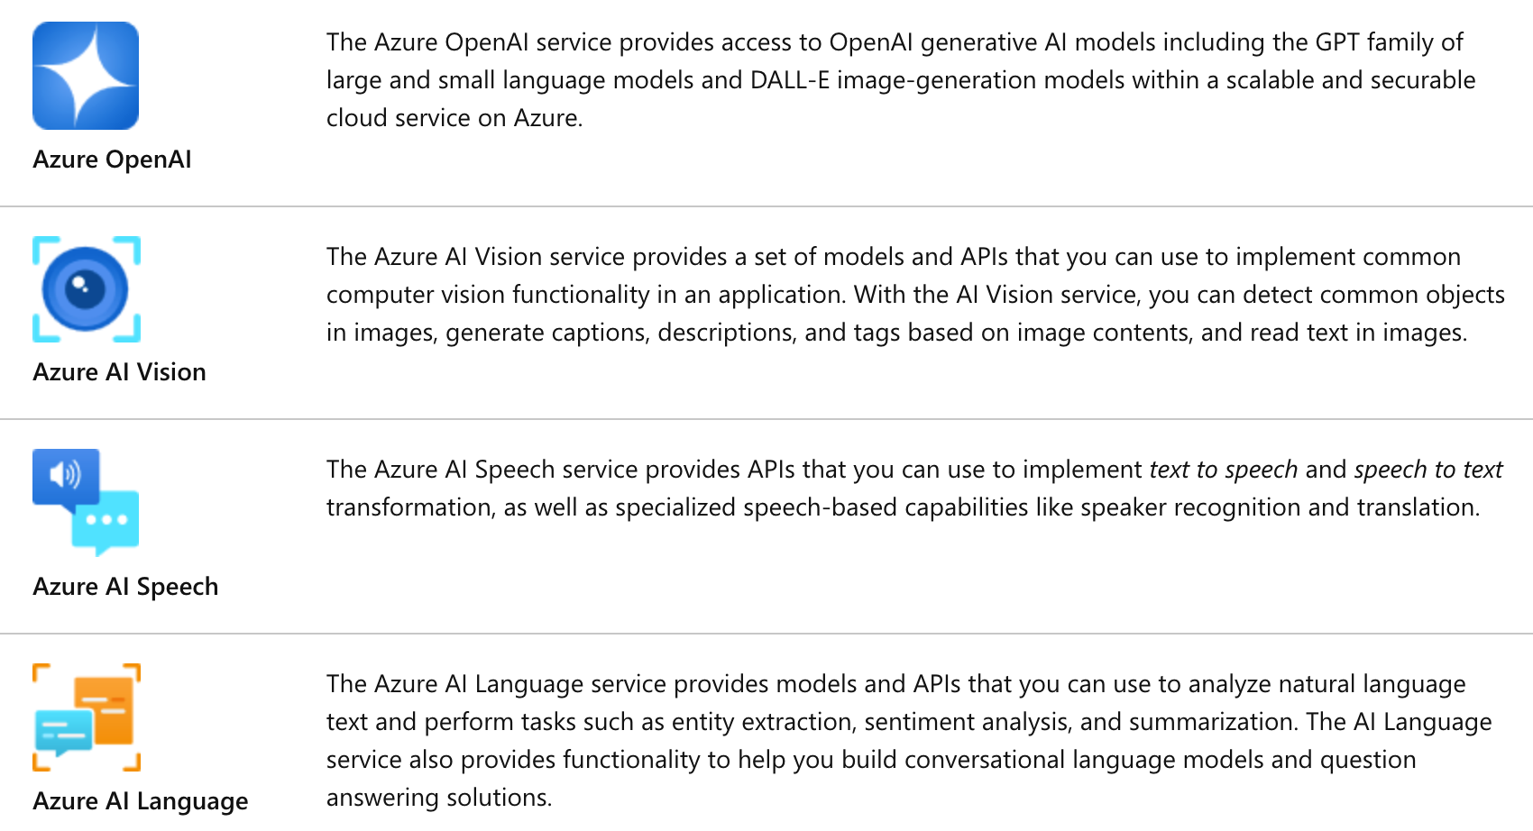
PLANNING AND OPERATIONS
Lab 01: Imported Reference Diagram
How to use it
Connect the diagram to the lab scenario: A company wants a customer support AI platform with document search, answer generation, sentiment analysis, sp...
Use it as a reference while completing the design steps.
Imported from source PPT slide 25.
Microsoft Certified Azure AI Engineer Associate AI-102 Training | TGS-2023036651
Copyright 2026 Tertiary Infotech Academy Pte Ltd. All rights reserved.
19

Slide 20
FOLLOW IN ORDER
Lab 01: Step Sequence
1. Map Requirements to Services
2. Plan Foundry Resources
3. Plan Security
4. Plan Monitoring and Cost
5. Draw Architecture
Microsoft Certified Azure AI Engineer Associate AI-102 Training | TGS-2023036651
Copyright 2026 Tertiary Infotech Academy Pte Ltd. All rights reserved.
20

Slide 21
DETAILED LAB GUIDE | STEP 1 OF 5
Lab 01 Step 1: Map Requirements to Services
Plan, Manage, Monitor, and Secure an Azure AI Solution
Requirement | Service
Generate responses | Azure OpenAI in Foundry Models
Search internal documents | Azure AI Search
Analyze sentiment | Azure AI Language
Transcribe calls | Azure AI Speech
Extract text from images | Azure AI Vision
Extract invoice fields | Azure AI Document Intelligence
Record the required output in your lab notes and verify it before continuing.
Microsoft Certified Azure AI Engineer Associate AI-102 Training | TGS-2023036651
Copyright 2026 Tertiary Infotech Academy Pte Ltd. All rights reserved.
21

Slide 22
DETAILED LAB GUIDE | STEP 2 OF 5
Lab 01 Step 2: Plan Foundry Resources
Plan, Manage, Monitor, and Secure an Azure AI Solution
Document:
Hub or project name Region Model deployment Default endpoint Connected data source Responsible AI settings
Record the required output in your lab notes and verify it before continuing.
Microsoft Certified Azure AI Engineer Associate AI-102 Training | TGS-2023036651
Copyright 2026 Tertiary Infotech Academy Pte Ltd. All rights reserved.
22

Slide 23
DETAILED LAB GUIDE | STEP 3 OF 5
Lab 01 Step 3: Plan Security
Plan, Manage, Monitor, and Secure an Azure AI Solution
Record:
-
Role-based access control.
-
Managed identities.
-
Key protection.
-
Private endpoint or network controls.
-
Logging and diagnostics.
-
Secrets storage.
Record the required output in your lab notes and verify it before continuing.
Microsoft Certified Azure AI Engineer Associate AI-102 Training | TGS-2023036651
Copyright 2026 Tertiary Infotech Academy Pte Ltd. All rights reserved.
23

Slide 24
DETAILED LAB GUIDE | STEP 4 OF 5
Lab 01 Step 4: Plan Monitoring and Cost
Plan, Manage, Monitor, and Secure an Azure AI Solution
Document:
Token or transaction usage Latency Errors Content safety events Budget alerts Diagnostic logs
Record the required output in your lab notes and verify it before continuing.
Microsoft Certified Azure AI Engineer Associate AI-102 Training | TGS-2023036651
Copyright 2026 Tertiary Infotech Academy Pte Ltd. All rights reserved.
24

Slide 25
DETAILED LAB GUIDE | STEP 5 OF 5
Lab 01 Step 5: Draw Architecture
Plan, Manage, Monitor, and Secure an Azure AI Solution
Use diagrams.net:
Application -> API layer -> Foundry/Azure AI services -> Search index/storage -> Monitoring
Record the required output in your lab notes and verify it before continuing.
Microsoft Certified Azure AI Engineer Associate AI-102 Training | TGS-2023036651
Copyright 2026 Tertiary Infotech Academy Pte Ltd. All rights reserved.
25

Slide 26
CHECK BEFORE MOVING ON
Lab 01: Validation and Checkpoints
You should have a service map, security plan, monitoring plan, and architecture diagram.
Why is service selection part of AI engineering?
Why should keys be protected?
What should be monitored in an AI service?
What is the role of responsible AI planning?
Microsoft Certified Azure AI Engineer Associate AI-102 Training | TGS-2023036651
Copyright 2026 Tertiary Infotech Academy Pte Ltd. All rights reserved.
26

Slide 27
LAB OVERVIEW
Lab 02: Responsible AI, Content Safety, Governance
Main topic: Responsible AI
Scenario: The support AI assistant may receive abusive user input, produce inaccurate answers, or expose sensitive data. You must design responsible AI controls.
Validation: You should have responsible AI controls, safety policy, scenario decisions, and incident plan.
Microsoft Certified Azure AI Engineer Associate AI-102 Training | TGS-2023036651
Copyright 2026 Tertiary Infotech Academy Pte Ltd. All rights reserved.
27

Slide 28
WHAT YOU WILL DO
Lab 02: Objectives
Apply responsible AI principles.
Configure content safety concepts.
Explain content filters, blocklists, prompt shields, and harm detection.
Design a responsible AI governance framework.
Microsoft Certified Azure AI Engineer Associate AI-102 Training | TGS-2023036651
Copyright 2026 Tertiary Infotech Academy Pte Ltd. All rights reserved.
28

Slide 29
RESPONSIBLE AI
Lab 02: Lab Alignment Diagram
Lab-aligned design flow
Scenario
>
Plan
>
Configure / Design
>
Validate
>
Review
Scenario
The support AI assistant may receive abusive user input, produce inaccurate answers, or expose sensitive data. You must design responsible AI controls.
Lab steps
Review Responsible AI Principles
Define Content Safety Controls
Create a Safety Policy
Test Governance Scenarios
Create an Incident Plan
Validation
You should have responsible AI controls, safety policy, scenario decisions, and incident plan.
Microsoft Certified Azure AI Engineer Associate AI-102 Training | TGS-2023036651
Copyright 2026 Tertiary Infotech Academy Pte Ltd. All rights reserved.
29

Slide 30
FOLLOW IN ORDER
Lab 02: Step Sequence
1. Review Responsible AI Principles
2. Define Content Safety Controls
3. Create a Safety Policy
4. Test Governance Scenarios
5. Create an Incident Plan
Microsoft Certified Azure AI Engineer Associate AI-102 Training | TGS-2023036651
Copyright 2026 Tertiary Infotech Academy Pte Ltd. All rights reserved.
30

Slide 31
DETAILED LAB GUIDE | STEP 1 OF 5
Lab 02 Step 1: Review Responsible AI Principles
Responsible AI, Content Safety, Governance
Write one control for:
Fairness Reliability and safety Privacy and security Inclusiveness Transparency Accountability
Record the required output in your lab notes and verify it before continuing.
Microsoft Certified Azure AI Engineer Associate AI-102 Training | TGS-2023036651
Copyright 2026 Tertiary Infotech Academy Pte Ltd. All rights reserved.
31

Slide 32
DETAILED LAB GUIDE | STEP 2 OF 5
Lab 02 Step 2: Define Content Safety Controls
Responsible AI, Content Safety, Governance
Document:
-
Harm categories.
-
Severity levels.
-
Content filters.
-
Blocklists.
-
Prompt shields.
-
Groundedness checks.
-
Human escalation rules.
Record the required output in your lab notes and verify it before continuing.
Microsoft Certified Azure AI Engineer Associate AI-102 Training | TGS-2023036651
Copyright 2026 Tertiary Infotech Academy Pte Ltd. All rights reserved.
32

Slide 33
DETAILED LAB GUIDE | STEP 3 OF 5
Lab 02 Step 3: Create a Safety Policy
Responsible AI, Content Safety, Governance
Write:
Allowed use: Disallowed use: Blocked content: Human review trigger: Audit log requirement: Escalation owner: Review frequency:
Record the required output in your lab notes and verify it before continuing.
Microsoft Certified Azure AI Engineer Associate AI-102 Training | TGS-2023036651
Copyright 2026 Tertiary Infotech Academy Pte Ltd. All rights reserved.
33

Slide 34
DETAILED LAB GUIDE | STEP 4 OF 5
Lab 02 Step 4: Test Governance Scenarios
Responsible AI, Content Safety, Governance
Decide what should happen when:
-
User asks for harmful instructions.
-
Model produces low-confidence answer.
-
Prompt contains personal data.
-
Retrieved document is outdated.
-
User asks for legal advice.
Record the required output in your lab notes and verify it before continuing.
Microsoft Certified Azure AI Engineer Associate AI-102 Training | TGS-2023036651
Copyright 2026 Tertiary Infotech Academy Pte Ltd. All rights reserved.
34

Slide 35
DETAILED LAB GUIDE | STEP 5 OF 5
Lab 02 Step 5: Create an Incident Plan
Responsible AI, Content Safety, Governance
Define how to report, investigate, remediate, and prevent repeat AI safety incidents.
Record the required output in your lab notes and verify it before continuing.
Microsoft Certified Azure AI Engineer Associate AI-102 Training | TGS-2023036651
Copyright 2026 Tertiary Infotech Academy Pte Ltd. All rights reserved.
35

Slide 36
CHECK BEFORE MOVING ON
Lab 02: Validation and Checkpoints
You should have responsible AI controls, safety policy, scenario decisions, and incident plan.
What are content filters?
What is a prompt shield?
Why is human escalation important?
Who is accountable for AI output?
Microsoft Certified Azure AI Engineer Associate AI-102 Training | TGS-2023036651
Copyright 2026 Tertiary Infotech Academy Pte Ltd. All rights reserved.
36

Slide 37
LAB OVERVIEW
Lab 03: Generative AI, Foundry, Azure OpenAI, Prompt Flow, RAG
Main topic: Generative AI
Scenario: The company wants a grounded assistant that answers questions from internal support articles and generates draft replies.
Validation: You should have model selection notes, prompt templates, prompt flow diagram, RAG design, and evaluation table.
Microsoft Certified Azure AI Engineer Associate AI-102 Training | TGS-2023036651
Copyright 2026 Tertiary Infotech Academy Pte Ltd. All rights reserved.
37

Slide 38
WHAT YOU WILL DO
Lab 03: Objectives
Plan a generative AI solution with Microsoft Foundry.
Select and deploy a model conceptually.
Design prompt templates and prompt flow.
Implement a RAG pattern conceptually.
Evaluate model and flow outputs.
Microsoft Certified Azure AI Engineer Associate AI-102 Training | TGS-2023036651
Copyright 2026 Tertiary Infotech Academy Pte Ltd. All rights reserved.
38

Slide 39

GENERATIVE AI
Lab 03: Imported Reference Diagram
How to use it
Connect the diagram to the lab scenario: The company wants a grounded assistant that answers questions from internal support articles and generates dra...
Use it as a reference while completing the design steps.
Imported from source PPT slide 309.
Microsoft Certified Azure AI Engineer Associate AI-102 Training | TGS-2023036651
Copyright 2026 Tertiary Infotech Academy Pte Ltd. All rights reserved.
39

Slide 40
FOLLOW IN ORDER
Lab 03: Step Sequence
1. Select a Model
2. Design Prompt Templates
3. Plan Prompt Flow
4. Design RAG
5. Evaluate Outputs
Microsoft Certified Azure AI Engineer Associate AI-102 Training | TGS-2023036651
Copyright 2026 Tertiary Infotech Academy Pte Ltd. All rights reserved.
40

Slide 41
DETAILED LAB GUIDE | STEP 1 OF 5
Lab 03 Step 1: Select a Model
Generative AI, Foundry, Azure OpenAI, Prompt Flow, RAG
Record:
Model name Use case fit Context window Latency Cost Safety settings Deployment option
Record the required output in your lab notes and verify it before continuing.
Microsoft Certified Azure AI Engineer Associate AI-102 Training | TGS-2023036651
Copyright 2026 Tertiary Infotech Academy Pte Ltd. All rights reserved.
41

Slide 42
DETAILED LAB GUIDE | STEP 2 OF 5
Lab 03 Step 2: Design Prompt Templates
Generative AI, Foundry, Azure OpenAI, Prompt Flow, RAG
Create templates for:
-
Direct answer.
-
Answer with sources.
-
Escalation when context is missing.
Record the required output in your lab notes and verify it before continuing.
Microsoft Certified Azure AI Engineer Associate AI-102 Training | TGS-2023036651
Copyright 2026 Tertiary Infotech Academy Pte Ltd. All rights reserved.
42

Slide 43
DETAILED LAB GUIDE | STEP 3 OF 5
Lab 03 Step 3: Plan Prompt Flow
Generative AI, Foundry, Azure OpenAI, Prompt Flow, RAG
Draw:
User question -> classify intent -> retrieve context -> prompt template -> model -> safety check -> response
Record the required output in your lab notes and verify it before continuing.
Microsoft Certified Azure AI Engineer Associate AI-102 Training | TGS-2023036651
Copyright 2026 Tertiary Infotech Academy Pte Ltd. All rights reserved.
43

Slide 44
DETAILED LAB GUIDE | STEP 4 OF 5
Lab 03 Step 4: Design RAG
Generative AI, Foundry, Azure OpenAI, Prompt Flow, RAG
Document:
-
Source documents.
-
Cleaning.
-
Chunking.
-
Embeddings.
-
Vector store.
-
Retrieval filters.
-
Citation format.
-
Evaluation method.
Record the required output in your lab notes and verify it before continuing.
Microsoft Certified Azure AI Engineer Associate AI-102 Training | TGS-2023036651
Copyright 2026 Tertiary Infotech Academy Pte Ltd. All rights reserved.
44

Slide 45
DETAILED LAB GUIDE | STEP 5 OF 5
Lab 03 Step 5: Evaluate Outputs
Generative AI, Foundry, Azure OpenAI, Prompt Flow, RAG
Score:
Criterion | Score 1-5
Correctness
Grounding
Helpfulness
Safety
Conciseness
Record the required output in your lab notes and verify it before continuing.
Microsoft Certified Azure AI Engineer Associate AI-102 Training | TGS-2023036651
Copyright 2026 Tertiary Infotech Academy Pte Ltd. All rights reserved.
45

Slide 46
CHECK BEFORE MOVING ON
Lab 03: Validation and Checkpoints
You should have model selection notes, prompt templates, prompt flow diagram, RAG design, and evaluation table.
What is RAG?
Why are prompt templates useful?
What does tracing help debug?
How can feedback improve a generative AI solution?
Microsoft Certified Azure AI Engineer Associate AI-102 Training | TGS-2023036651
Copyright 2026 Tertiary Infotech Academy Pte Ltd. All rights reserved.
46

Slide 47
LAB OVERVIEW
Lab 04: Agentic AI, Foundry Agent Service, Multi-Agent Concepts
Main topic: Agents
Scenario: The support AI assistant needs to look up order status, search support documents, draft a reply, and escalate complex cases to a human agent.
Validation: You should have agent use case, resource plan, tool table, orchestration diagram, and multi-agent notes.
Microsoft Certified Azure AI Engineer Associate AI-102 Training | TGS-2023036651
Copyright 2026 Tertiary Infotech Academy Pte Ltd. All rights reserved.
47

Slide 48
WHAT YOU WILL DO
Lab 04: Objectives
Explain agent roles and use cases.
Plan Foundry Agent Service resources.
Design custom agent tools and workflows.
Review multi-agent orchestration concepts.
Microsoft Certified Azure AI Engineer Associate AI-102 Training | TGS-2023036651
Copyright 2026 Tertiary Infotech Academy Pte Ltd. All rights reserved.
48

Slide 49
AGENTS
Lab 04: Lab Alignment Diagram
Lab-aligned design flow
Scenario
>
Plan
>
Configure / Design
>
Validate
>
Review
Scenario
The support AI assistant needs to look up order status, search support documents, draft a reply, and escalate complex cases to a human agent.
Lab steps
Define Agent Use Case
Plan Agent Resources
Design Tool Calls
Design Orchestration
Multi-Agent Review
Validation
You should have agent use case, resource plan, tool table, orchestration diagram, and multi-agent notes.
Microsoft Certified Azure AI Engineer Associate AI-102 Training | TGS-2023036651
Copyright 2026 Tertiary Infotech Academy Pte Ltd. All rights reserved.
49

Slide 50
FOLLOW IN ORDER
Lab 04: Step Sequence
1. Define Agent Use Case
2. Plan Agent Resources
3. Design Tool Calls
4. Design Orchestration
5. Multi-Agent Review
Microsoft Certified Azure AI Engineer Associate AI-102 Training | TGS-2023036651
Copyright 2026 Tertiary Infotech Academy Pte Ltd. All rights reserved.
50

Slide 51
DETAILED LAB GUIDE | STEP 1 OF 5
Lab 04 Step 1: Define Agent Use Case
Agentic AI, Foundry Agent Service, Multi-Agent Concepts
Write:
Agent goal: User types: Allowed tools: Disallowed actions: Human escalation trigger: Success metric:
Record the required output in your lab notes and verify it before continuing.
Microsoft Certified Azure AI Engineer Associate AI-102 Training | TGS-2023036651
Copyright 2026 Tertiary Infotech Academy Pte Ltd. All rights reserved.
51

Slide 52
DETAILED LAB GUIDE | STEP 2 OF 5
Lab 04 Step 2: Plan Agent Resources
Agentic AI, Foundry Agent Service, Multi-Agent Concepts
Document:
-
Foundry project.
-
Model deployment.
-
Search tool.
-
Function or API tools.
-
Authentication.
-
Logging and trace settings.
Record the required output in your lab notes and verify it before continuing.
Microsoft Certified Azure AI Engineer Associate AI-102 Training | TGS-2023036651
Copyright 2026 Tertiary Infotech Academy Pte Ltd. All rights reserved.
52

Slide 53
DETAILED LAB GUIDE | STEP 3 OF 5
Lab 04 Step 3: Design Tool Calls
Agentic AI, Foundry Agent Service, Multi-Agent Concepts
Create a table:
Tool | Purpose | Input | Output
Search knowledge base | Retrieve support articles | Query | Relevant passages
Order lookup | Get order status | Order ID | Status summary
Record the required output in your lab notes and verify it before continuing.
Microsoft Certified Azure AI Engineer Associate AI-102 Training | TGS-2023036651
Copyright 2026 Tertiary Infotech Academy Pte Ltd. All rights reserved.
53

Slide 54
DETAILED LAB GUIDE | STEP 4 OF 5
Lab 04 Step 4: Design Orchestration
Agentic AI, Foundry Agent Service, Multi-Agent Concepts
Draw:
User request -> agent plan -> tool call -> observation -> model reasoning -> response -> feedback
Record the required output in your lab notes and verify it before continuing.
Microsoft Certified Azure AI Engineer Associate AI-102 Training | TGS-2023036651
Copyright 2026 Tertiary Infotech Academy Pte Ltd. All rights reserved.
54

Slide 55
DETAILED LAB GUIDE | STEP 5 OF 5
Lab 04 Step 5: Multi-Agent Review
Agentic AI, Foundry Agent Service, Multi-Agent Concepts
Explain when separate agents might be useful for retrieval, billing, technical support, and escalation review.
Record the required output in your lab notes and verify it before continuing.
Microsoft Certified Azure AI Engineer Associate AI-102 Training | TGS-2023036651
Copyright 2026 Tertiary Infotech Academy Pte Ltd. All rights reserved.
55

Slide 56
CHECK BEFORE MOVING ON
Lab 04: Validation and Checkpoints
You should have agent use case, resource plan, tool table, orchestration diagram, and multi-agent notes.
What is an AI agent?
Why do agents need tool permissions?
What is orchestration?
Why should autonomous actions be constrained?
Microsoft Certified Azure AI Engineer Associate AI-102 Training | TGS-2023036651
Copyright 2026 Tertiary Infotech Academy Pte Ltd. All rights reserved.
56

Slide 57
LAB OVERVIEW
Lab 05: Computer Vision, Custom Vision, Video Insights
Main topic: Vision
Scenario: The company wants to inspect product photos, detect damaged items, read text from images, and extract insights from product demo videos.
Validation: You should have vision mapping, request plan, custom vision plan, video insight notes, and responsible AI review.
Microsoft Certified Azure AI Engineer Associate AI-102 Training | TGS-2023036651
Copyright 2026 Tertiary Infotech Academy Pte Ltd. All rights reserved.
57

Slide 58
WHAT YOU WILL DO
Lab 05: Objectives
Analyze images with Azure AI Vision concepts.
Select visual features for image processing requirements.
Compare image classification and object detection.
Plan custom vision training.
Explain video insight scenarios.
Microsoft Certified Azure AI Engineer Associate AI-102 Training | TGS-2023036651
Copyright 2026 Tertiary Infotech Academy Pte Ltd. All rights reserved.
58

Slide 59
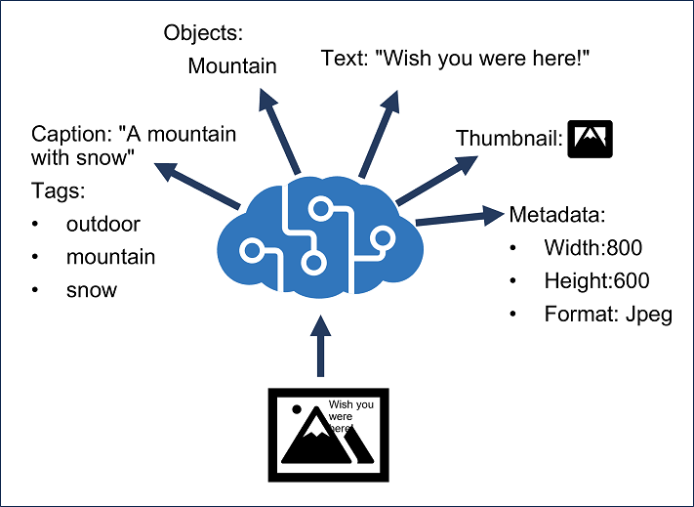
VISION
Lab 05: Imported Reference Diagram
How to use it
Connect the diagram to the lab scenario: The company wants to inspect product photos, detect damaged items, read text from images, and extract insights...
Use it as a reference while completing the design steps.
Imported from source PPT slide 73.
Microsoft Certified Azure AI Engineer Associate AI-102 Training | TGS-2023036651
Copyright 2026 Tertiary Infotech Academy Pte Ltd. All rights reserved.
59

Slide 60
FOLLOW IN ORDER
Lab 05: Step Sequence
1. Map Vision Requirements
2. Plan an Image Request
3. Custom Vision Plan
4. Video Insights Plan
5. Responsible AI Review
Microsoft Certified Azure AI Engineer Associate AI-102 Training | TGS-2023036651
Copyright 2026 Tertiary Infotech Academy Pte Ltd. All rights reserved.
60

Slide 61
DETAILED LAB GUIDE | STEP 1 OF 5
Lab 05 Step 1: Map Vision Requirements
Computer Vision, Custom Vision, Video Insights
Requirement | Vision Capability
Generate image tags | Image analysis
Detect product locations | Object detection
Read text from photos | OCR
Classify product condition | Image classification
Extract video topics | Video insights
Record the required output in your lab notes and verify it before continuing.
Microsoft Certified Azure AI Engineer Associate AI-102 Training | TGS-2023036651
Copyright 2026 Tertiary Infotech Academy Pte Ltd. All rights reserved.
61

Slide 62
DETAILED LAB GUIDE | STEP 2 OF 5
Lab 05 Step 2: Plan an Image Request
Computer Vision, Custom Vision, Video Insights
Document:
Image source Visual features Language Expected response fields Error handling Privacy considerations
Record the required output in your lab notes and verify it before continuing.
Microsoft Certified Azure AI Engineer Associate AI-102 Training | TGS-2023036651
Copyright 2026 Tertiary Infotech Academy Pte Ltd. All rights reserved.
62

Slide 63
DETAILED LAB GUIDE | STEP 3 OF 5
Lab 05 Step 3: Custom Vision Plan
Computer Vision, Custom Vision, Video Insights
Choose:
Need | Model Type
One label for each image | Image classification
Locate multiple objects | Object detection
Document image labels, training images, evaluation metrics, publishing, and consumption.
Record the required output in your lab notes and verify it before continuing.
Microsoft Certified Azure AI Engineer Associate AI-102 Training | TGS-2023036651
Copyright 2026 Tertiary Infotech Academy Pte Ltd. All rights reserved.
63

Slide 64
DETAILED LAB GUIDE | STEP 4 OF 5
Lab 05 Step 4: Video Insights Plan
Computer Vision, Custom Vision, Video Insights
Explain how Video Indexer can extract:
-
Transcript.
-
Keywords.
-
Faces or speakers where appropriate.
-
Topics.
-
Scenes.
Record the required output in your lab notes and verify it before continuing.
Microsoft Certified Azure AI Engineer Associate AI-102 Training | TGS-2023036651
Copyright 2026 Tertiary Infotech Academy Pte Ltd. All rights reserved.
64

Slide 65
DETAILED LAB GUIDE | STEP 5 OF 5
Lab 05 Step 5: Responsible AI Review
Computer Vision, Custom Vision, Video Insights
Document consent, retention, face analysis sensitivity, and human review needs.
Record the required output in your lab notes and verify it before continuing.
Microsoft Certified Azure AI Engineer Associate AI-102 Training | TGS-2023036651
Copyright 2026 Tertiary Infotech Academy Pte Ltd. All rights reserved.
65

Slide 66
CHECK BEFORE MOVING ON
Lab 05: Validation and Checkpoints
You should have vision mapping, request plan, custom vision plan, video insight notes, and responsible AI review.
What is OCR?
How is object detection different from classification?
What does a custom vision model require?
Why is video analysis sensitive?
Microsoft Certified Azure AI Engineer Associate AI-102 Training | TGS-2023036651
Copyright 2026 Tertiary Infotech Academy Pte Ltd. All rights reserved.
66

Slide 67
LAB OVERVIEW
Lab 06: NLP, Language, Speech, Translation
Main topic: Language and speech
Scenario: The support platform must analyze customer messages, detect PII, translate text, transcribe calls, and generate spoken responses.
Validation: You should have language task mapping, text pipeline, speech pipeline, SSML notes, and translation notes.
Microsoft Certified Azure AI Engineer Associate AI-102 Training | TGS-2023036651
Copyright 2026 Tertiary Infotech Academy Pte Ltd. All rights reserved.
67

Slide 68
WHAT YOU WILL DO
Lab 06: Objectives
Analyze and translate text.
Extract key phrases, entities, PII, language, and sentiment.
Process speech with speech-to-text and text-to-speech.
Plan translation and SSML use.
Microsoft Certified Azure AI Engineer Associate AI-102 Training | TGS-2023036651
Copyright 2026 Tertiary Infotech Academy Pte Ltd. All rights reserved.
68

Slide 69
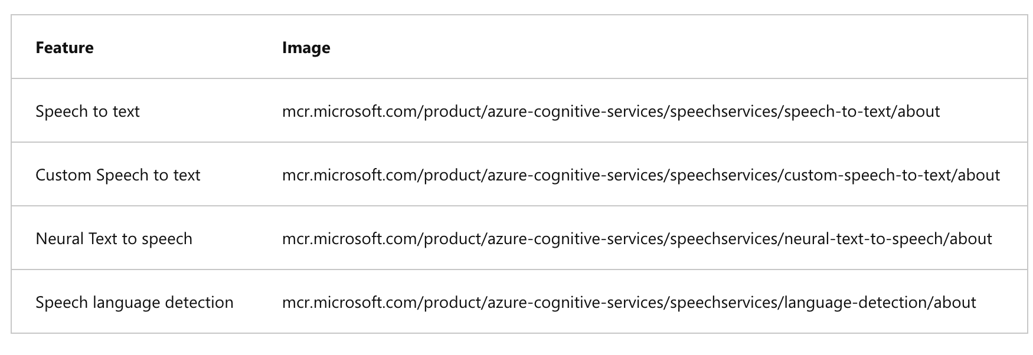
LANGUAGE AND SPEECH
Lab 06: Imported Reference Diagram
How to use it
Connect the diagram to the lab scenario: The support platform must analyze customer messages, detect PII, translate text, transcribe calls, and generat...
Use it as a reference while completing the design steps.
Imported from source PPT slide 61.
Microsoft Certified Azure AI Engineer Associate AI-102 Training | TGS-2023036651
Copyright 2026 Tertiary Infotech Academy Pte Ltd. All rights reserved.
69

Slide 70
FOLLOW IN ORDER
Lab 06: Step Sequence
1. Map Language Tasks
2. Design Text Analysis Pipeline
3. Design Speech Pipeline
4. SSML Review
5. Translation Review
Microsoft Certified Azure AI Engineer Associate AI-102 Training | TGS-2023036651
Copyright 2026 Tertiary Infotech Academy Pte Ltd. All rights reserved.
70

Slide 71
DETAILED LAB GUIDE | STEP 1 OF 5
Lab 06 Step 1: Map Language Tasks
NLP, Language, Speech, Translation
Scenario | Capability
Identify customer sentiment | Sentiment analysis
Extract product names | Entity recognition
Identify important topics | Key phrase extraction
Detect personal data | PII detection
Detect message language | Language detection
Translate message | Translator
Record the required output in your lab notes and verify it before continuing.
Microsoft Certified Azure AI Engineer Associate AI-102 Training | TGS-2023036651
Copyright 2026 Tertiary Infotech Academy Pte Ltd. All rights reserved.
71

Slide 72
DETAILED LAB GUIDE | STEP 2 OF 5
Lab 06 Step 2: Design Text Analysis Pipeline
NLP, Language, Speech, Translation
Input text -> language detection -> PII detection -> sentiment -> entities -> key phrases -> route case
Record the required output in your lab notes and verify it before continuing.
Microsoft Certified Azure AI Engineer Associate AI-102 Training | TGS-2023036651
Copyright 2026 Tertiary Infotech Academy Pte Ltd. All rights reserved.
72

Slide 73
DETAILED LAB GUIDE | STEP 3 OF 5
Lab 06 Step 3: Design Speech Pipeline
NLP, Language, Speech, Translation
Audio input -> speech to text -> intent or keyword recognition -> response -> text to speech
Record the required output in your lab notes and verify it before continuing.
Microsoft Certified Azure AI Engineer Associate AI-102 Training | TGS-2023036651
Copyright 2026 Tertiary Infotech Academy Pte Ltd. All rights reserved.
73

Slide 74
DETAILED LAB GUIDE | STEP 4 OF 5
Lab 06 Step 4: SSML Review
NLP, Language, Speech, Translation
Explain how SSML can control voice, pitch, rate, pauses, and pronunciation.
Record the required output in your lab notes and verify it before continuing.
Microsoft Certified Azure AI Engineer Associate AI-102 Training | TGS-2023036651
Copyright 2026 Tertiary Infotech Academy Pte Ltd. All rights reserved.
74

Slide 75
DETAILED LAB GUIDE | STEP 5 OF 5
Lab 06 Step 5: Translation Review
NLP, Language, Speech, Translation
Document:
-
Text translation.
-
Document translation.
-
Speech-to-text translation.
-
Speech-to-speech translation.
-
Human review for critical messages.
Record the required output in your lab notes and verify it before continuing.
Microsoft Certified Azure AI Engineer Associate AI-102 Training | TGS-2023036651
Copyright 2026 Tertiary Infotech Academy Pte Ltd. All rights reserved.
75

Slide 76
CHECK BEFORE MOVING ON
Lab 06: Validation and Checkpoints
You should have language task mapping, text pipeline, speech pipeline, SSML notes, and translation notes.
What is entity recognition?
Why detect PII before storing text?
What is SSML?
When should translation outputs be reviewed?
Microsoft Certified Azure AI Engineer Associate AI-102 Training | TGS-2023036651
Copyright 2026 Tertiary Infotech Academy Pte Ltd. All rights reserved.
76

Slide 77
AI-102 INTEGRATION AND REVIEW
Day 2
Custom language, search, document intelligence, capstone and assessment.
Microsoft Certified Azure AI Engineer Associate AI-102 Training | TGS-2023036651
Copyright 2026 Tertiary Infotech Academy Pte Ltd. All rights reserved.
77

Slide 78
LAB OVERVIEW
Lab 07: Custom Language Models and Question Answering
Main topic: Custom language
Scenario: The support assistant must recognize customer intents and answer frequently asked questions from approved sources.
Validation: You should have intent/entity table, training plan, question answering plan, multilingual strategy, and backup notes.
Microsoft Certified Azure AI Engineer Associate AI-102 Training | TGS-2023036651
Copyright 2026 Tertiary Infotech Academy Pte Ltd. All rights reserved.
78

Slide 79
WHAT YOU WILL DO
Lab 07: Objectives
Design custom language understanding.
Define intents, entities, and utterances.
Plan custom question answering.
Create a multilingual question answering strategy.
Microsoft Certified Azure AI Engineer Associate AI-102 Training | TGS-2023036651
Copyright 2026 Tertiary Infotech Academy Pte Ltd. All rights reserved.
79

Slide 80
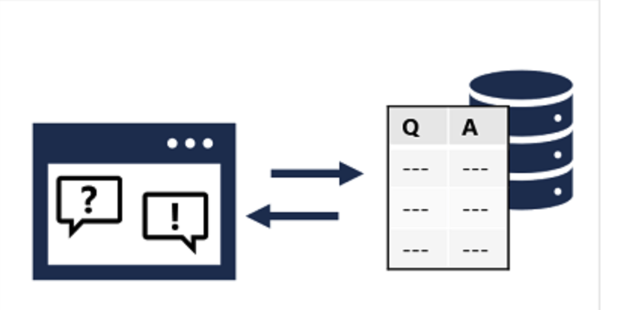
CUSTOM LANGUAGE
Lab 07: Imported Reference Diagram
How to use it
Connect the diagram to the lab scenario: The support assistant must recognize customer intents and answer frequently asked questions from approved sour...
Use it as a reference while completing the design steps.
Imported from source PPT slide 149.
Microsoft Certified Azure AI Engineer Associate AI-102 Training | TGS-2023036651
Copyright 2026 Tertiary Infotech Academy Pte Ltd. All rights reserved.
80

Slide 81
FOLLOW IN ORDER
Lab 07: Step Sequence
1. Define Intents and Entities
2. Plan Training Data
3. Plan Custom Question Answering
4. Multilingual Strategy
5. Backup and Recovery
Microsoft Certified Azure AI Engineer Associate AI-102 Training | TGS-2023036651
Copyright 2026 Tertiary Infotech Academy Pte Ltd. All rights reserved.
81

Slide 82
DETAILED LAB GUIDE | STEP 1 OF 5
Lab 07 Step 1: Define Intents and Entities
Custom Language Models and Question Answering
Create a table:
Intent | Example Utterance | Entities
CheckOrderStatus | Where is order 12345? | order number
RequestRefund | I want a refund for my laptop | product
Record the required output in your lab notes and verify it before continuing.
Microsoft Certified Azure AI Engineer Associate AI-102 Training | TGS-2023036651
Copyright 2026 Tertiary Infotech Academy Pte Ltd. All rights reserved.
82

Slide 83
DETAILED LAB GUIDE | STEP 2 OF 5
Lab 07 Step 2: Plan Training Data
Custom Language Models and Question Answering
Document:
-
Number of example utterances.
-
Balanced examples across intents.
-
Entity labeling rules.
-
Test set.
-
Ambiguous utterances.
Record the required output in your lab notes and verify it before continuing.
Microsoft Certified Azure AI Engineer Associate AI-102 Training | TGS-2023036651
Copyright 2026 Tertiary Infotech Academy Pte Ltd. All rights reserved.
83

Slide 84
DETAILED LAB GUIDE | STEP 3 OF 5
Lab 07 Step 3: Plan Custom Question Answering
Custom Language Models and Question Answering
Record:
Knowledge sources Q&A pairs Alternate phrasing Chit-chat Multi-turn prompts Publishing target Fallback answer
Record the required output in your lab notes and verify it before continuing.
Microsoft Certified Azure AI Engineer Associate AI-102 Training | TGS-2023036651
Copyright 2026 Tertiary Infotech Academy Pte Ltd. All rights reserved.
84

Slide 85
DETAILED LAB GUIDE | STEP 4 OF 5
Lab 07 Step 4: Multilingual Strategy
Custom Language Models and Question Answering
Explain whether to translate sources, create separate projects, or translate user input before answering.
Record the required output in your lab notes and verify it before continuing.
Microsoft Certified Azure AI Engineer Associate AI-102 Training | TGS-2023036651
Copyright 2026 Tertiary Infotech Academy Pte Ltd. All rights reserved.
85

Slide 86
DETAILED LAB GUIDE | STEP 5 OF 5
Lab 07 Step 5: Backup and Recovery
Custom Language Models and Question Answering
Document export, versioning, backup, and recovery of language projects.
Record the required output in your lab notes and verify it before continuing.
Microsoft Certified Azure AI Engineer Associate AI-102 Training | TGS-2023036651
Copyright 2026 Tertiary Infotech Academy Pte Ltd. All rights reserved.
86

Slide 87
CHECK BEFORE MOVING ON
Lab 07: Validation and Checkpoints
You should have intent/entity table, training plan, question answering plan, multilingual strategy, and backup notes.
What is an intent?
What is an entity?
Why add alternate phrasing?
Why should language projects be backed up?
Microsoft Certified Azure AI Engineer Associate AI-102 Training | TGS-2023036651
Copyright 2026 Tertiary Infotech Academy Pte Ltd. All rights reserved.
87

Slide 88
LAB OVERVIEW
Lab 08: Azure AI Search, Knowledge Mining, Vector Search
Main topic: Search and mining
Scenario: The company wants searchable support documents, enriched with extracted text, entities, key phrases, and vector embeddings for RAG.
Validation: You should have index design, data source/indexer plan, skillset plan, query examples, and knowledge store notes.
Microsoft Certified Azure AI Engineer Associate AI-102 Training | TGS-2023036651
Copyright 2026 Tertiary Infotech Academy Pte Ltd. All rights reserved.
88

Slide 89
WHAT YOU WILL DO
Lab 08: Objectives
Design an Azure AI Search solution.
Define indexes, data sources, indexers, and skillsets.
Explain semantic and vector search.
Plan knowledge store projections.
Microsoft Certified Azure AI Engineer Associate AI-102 Training | TGS-2023036651
Copyright 2026 Tertiary Infotech Academy Pte Ltd. All rights reserved.
89

Slide 90
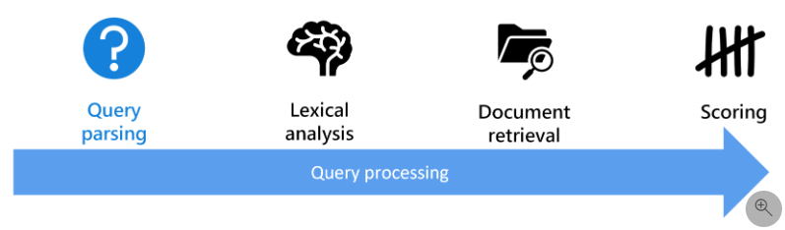
SEARCH AND MINING
Lab 08: Imported Reference Diagram
How to use it
Connect the diagram to the lab scenario: The company wants searchable support documents, enriched with extracted text, entities, key phrases, and vecto...
Use it as a reference while completing the design steps.
Imported from source PPT slide 380.
Microsoft Certified Azure AI Engineer Associate AI-102 Training | TGS-2023036651
Copyright 2026 Tertiary Infotech Academy Pte Ltd. All rights reserved.
90

Slide 91
FOLLOW IN ORDER
Lab 08: Step Sequence
1. Design an Index
2. Plan Data Sources and Indexers
3. Define a Skillset
4. Query Design
5. Knowledge Store Projections
Microsoft Certified Azure AI Engineer Associate AI-102 Training | TGS-2023036651
Copyright 2026 Tertiary Infotech Academy Pte Ltd. All rights reserved.
91

Slide 92
DETAILED LAB GUIDE | STEP 1 OF 5
Lab 08 Step 1: Design an Index
Azure AI Search, Knowledge Mining, Vector Search
Define fields:
id title content category source_url last_updated security_label embedding
Record the required output in your lab notes and verify it before continuing.
Microsoft Certified Azure AI Engineer Associate AI-102 Training | TGS-2023036651
Copyright 2026 Tertiary Infotech Academy Pte Ltd. All rights reserved.
92

Slide 93
DETAILED LAB GUIDE | STEP 2 OF 5
Lab 08 Step 2: Plan Data Sources and Indexers
Azure AI Search, Knowledge Mining, Vector Search
Document:
-
Source storage.
-
Supported document formats.
-
Indexer schedule.
-
Change detection.
-
Error handling.
Record the required output in your lab notes and verify it before continuing.
Microsoft Certified Azure AI Engineer Associate AI-102 Training | TGS-2023036651
Copyright 2026 Tertiary Infotech Academy Pte Ltd. All rights reserved.
93

Slide 94
DETAILED LAB GUIDE | STEP 3 OF 5
Lab 08 Step 3: Define a Skillset
Azure AI Search, Knowledge Mining, Vector Search
Include:
-
OCR.
-
Language detection.
-
Entity extraction.
-
Key phrase extraction.
-
Custom skill.
-
Embedding generation.
Record the required output in your lab notes and verify it before continuing.
Microsoft Certified Azure AI Engineer Associate AI-102 Training | TGS-2023036651
Copyright 2026 Tertiary Infotech Academy Pte Ltd. All rights reserved.
94

Slide 95
DETAILED LAB GUIDE | STEP 4 OF 5
Lab 08 Step 4: Query Design
Azure AI Search, Knowledge Mining, Vector Search
Write examples for:
Keyword search Filter by category Sort by last updated Wildcard query Semantic ranking Vector search Hybrid search
Record the required output in your lab notes and verify it before continuing.
Microsoft Certified Azure AI Engineer Associate AI-102 Training | TGS-2023036651
Copyright 2026 Tertiary Infotech Academy Pte Ltd. All rights reserved.
95

Slide 96
DETAILED LAB GUIDE | STEP 5 OF 5
Lab 08 Step 5: Knowledge Store Projections
Azure AI Search, Knowledge Mining, Vector Search
Explain file, object, and table projections and when enriched output should be stored.
Record the required output in your lab notes and verify it before continuing.
Microsoft Certified Azure AI Engineer Associate AI-102 Training | TGS-2023036651
Copyright 2026 Tertiary Infotech Academy Pte Ltd. All rights reserved.
96

Slide 97
CHECK BEFORE MOVING ON
Lab 08: Validation and Checkpoints
You should have index design, data source/indexer plan, skillset plan, query examples, and knowledge store notes.
What is an indexer?
What is a skillset?
What is vector search?
Why use semantic ranking?
Microsoft Certified Azure AI Engineer Associate AI-102 Training | TGS-2023036651
Copyright 2026 Tertiary Infotech Academy Pte Ltd. All rights reserved.
97

Slide 98
LAB OVERVIEW
Lab 09: Document Intelligence and Content Understanding
Main topic: Document AI
Scenario: The company processes invoices, contracts, support screenshots, audio notes, and product videos. It wants to extract structured information from multiple content types.
Validation: You should have scenario mapping, custom model plan, content understanding plan, review rules, and integration flow.
Microsoft Certified Azure AI Engineer Associate AI-102 Training | TGS-2023036651
Copyright 2026 Tertiary Infotech Academy Pte Ltd. All rights reserved.
98

Slide 99
WHAT YOU WILL DO
Lab 09: Objectives
Use prebuilt document extraction concepts.
Plan custom Document Intelligence models.
Explain composed models.
Design Content Understanding extraction workflows.
Microsoft Certified Azure AI Engineer Associate AI-102 Training | TGS-2023036651
Copyright 2026 Tertiary Infotech Academy Pte Ltd. All rights reserved.
99

Slide 100
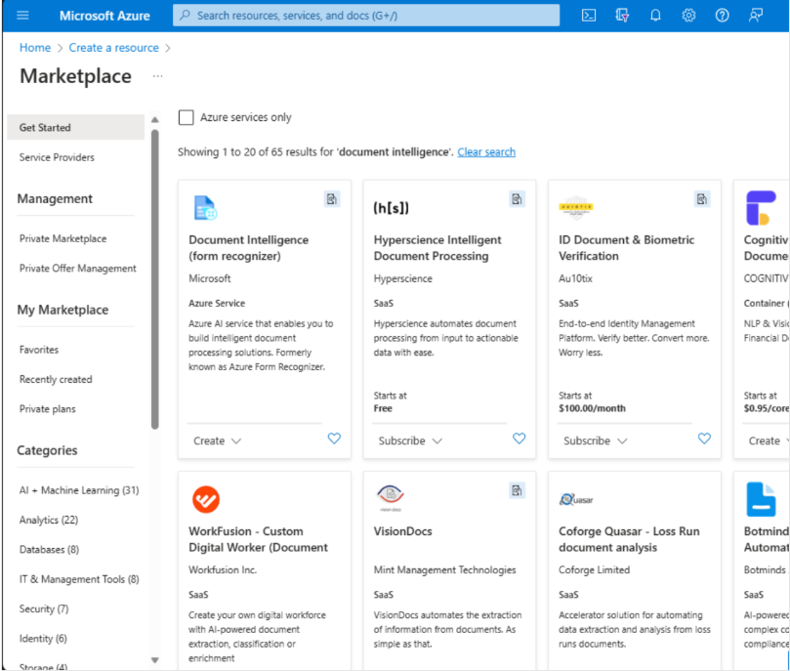
DOCUMENT AI
Lab 09: Imported Reference Diagram
How to use it
Connect the diagram to the lab scenario: The company processes invoices, contracts, support screenshots, audio notes, and product videos. It wants to e...
Use it as a reference while completing the design steps.
Imported from source PPT slide 532.
Microsoft Certified Azure AI Engineer Associate AI-102 Training | TGS-2023036651
Copyright 2026 Tertiary Infotech Academy Pte Ltd. All rights reserved.
100

Slide 101
FOLLOW IN ORDER
Lab 09: Step Sequence
1. Map Document Scenarios
2. Custom Document Model Plan
3. Content Understanding Plan
4. Human Review Rules
5. Integration Flow
Microsoft Certified Azure AI Engineer Associate AI-102 Training | TGS-2023036651
Copyright 2026 Tertiary Infotech Academy Pte Ltd. All rights reserved.
101

Slide 102
DETAILED LAB GUIDE | STEP 1 OF 5
Lab 09 Step 1: Map Document Scenarios
Document Intelligence and Content Understanding
Scenario | Capability
Extract invoice fields | Prebuilt invoice model
Extract custom form fields | Custom document model
Route different form types | Composed model
Extract table data | Layout and table extraction
Extract text from images | OCR pipeline
Record the required output in your lab notes and verify it before continuing.
Microsoft Certified Azure AI Engineer Associate AI-102 Training | TGS-2023036651
Copyright 2026 Tertiary Infotech Academy Pte Ltd. All rights reserved.
102

Slide 103
DETAILED LAB GUIDE | STEP 2 OF 5
Lab 09 Step 2: Custom Document Model Plan
Document Intelligence and Content Understanding
Document:
Document types Sample count Fields to extract Labels Training split Evaluation metric Publish plan
Record the required output in your lab notes and verify it before continuing.
Microsoft Certified Azure AI Engineer Associate AI-102 Training | TGS-2023036651
Copyright 2026 Tertiary Infotech Academy Pte Ltd. All rights reserved.
103

Slide 104
DETAILED LAB GUIDE | STEP 3 OF 5
Lab 09 Step 3: Content Understanding Plan
Document Intelligence and Content Understanding
Explain extraction from:
-
Documents.
-
Images.
-
Video.
-
Audio.
Include summarization, classification, attributes, entities, tables, and images.
Record the required output in your lab notes and verify it before continuing.
Microsoft Certified Azure AI Engineer Associate AI-102 Training | TGS-2023036651
Copyright 2026 Tertiary Infotech Academy Pte Ltd. All rights reserved.
104

Slide 105
DETAILED LAB GUIDE | STEP 4 OF 5
Lab 09 Step 4: Human Review Rules
Document Intelligence and Content Understanding
Define confidence thresholds and when extracted data requires review.
Record the required output in your lab notes and verify it before continuing.
Microsoft Certified Azure AI Engineer Associate AI-102 Training | TGS-2023036651
Copyright 2026 Tertiary Infotech Academy Pte Ltd. All rights reserved.
105

Slide 106
DETAILED LAB GUIDE | STEP 5 OF 5
Lab 09 Step 5: Integration Flow
Document Intelligence and Content Understanding
Draw:
Upload content -> extract text/entities/tables -> validate -> store structured data -> search/report
Record the required output in your lab notes and verify it before continuing.
Microsoft Certified Azure AI Engineer Associate AI-102 Training | TGS-2023036651
Copyright 2026 Tertiary Infotech Academy Pte Ltd. All rights reserved.
106

Slide 107
CHECK BEFORE MOVING ON
Lab 09: Validation and Checkpoints
You should have scenario mapping, custom model plan, content understanding plan, review rules, and integration flow.
When should you use a prebuilt model?
What is a composed model?
Why are confidence scores useful?
What content types can Content Understanding process?
Microsoft Certified Azure AI Engineer Associate AI-102 Training | TGS-2023036651
Copyright 2026 Tertiary Infotech Academy Pte Ltd. All rights reserved.
107

Slide 108
LAB OVERVIEW
Lab 10: AI-102 Capstone and Course Review
Main topic: Integrated review
Scenario: You must design a production-ready customer support AI platform that supports grounded chat, document search, sentiment analysis, speech transcription, image OCR, document extraction, and human escalation.
Validation: You should have a service map, architecture diagram, governance checklist, confidence matrix, cleanup plan, and review plan.
Microsoft Certified Azure AI Engineer Associate AI-102 Training | TGS-2023036651
Copyright 2026 Tertiary Infotech Academy Pte Ltd. All rights reserved.
108

Slide 109
WHAT YOU WILL DO
Lab 10: Objectives
Design an end-to-end Azure AI solution.
Map requirements to Microsoft Foundry and Azure AI services.
Include security, monitoring, responsible AI, and cost controls.
Build a personal review plan.
Microsoft Certified Azure AI Engineer Associate AI-102 Training | TGS-2023036651
Copyright 2026 Tertiary Infotech Academy Pte Ltd. All rights reserved.
109

Slide 110
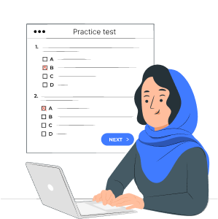
INTEGRATED REVIEW
Lab 10: Imported Reference Diagram
How to use it
Connect the diagram to the lab scenario: You must design a production-ready customer support AI platform that supports grounded chat, document search, ...
Use it as a reference while completing the design steps.
Imported from source PPT slide 716.
Microsoft Certified Azure AI Engineer Associate AI-102 Training | TGS-2023036651
Copyright 2026 Tertiary Infotech Academy Pte Ltd. All rights reserved.
110

Slide 111
FOLLOW IN ORDER
Lab 10: Step Sequence
1. Build a Service Map
2. Draw the Architecture
3. Add Governance Controls
4. Rate Skill Confidence
5. Clean Up Resources
6. Create a 7-Day Review Plan
Microsoft Certified Azure AI Engineer Associate AI-102 Training | TGS-2023036651
Copyright 2026 Tertiary Infotech Academy Pte Ltd. All rights reserved.
111

Slide 112
DETAILED LAB GUIDE | STEP 1 OF 6
Lab 10 Step 1: Build a Service Map
AI-102 Capstone and Course Review
Requirement | Service
Grounded assistant | Foundry, Azure OpenAI, prompt flow, RAG
Agent workflow | Foundry Agent Service
Document search | Azure AI Search
Sentiment and PII | Azure AI Language
Speech transcription | Azure AI Speech
Image OCR | Azure AI Vision
Invoice extraction | Document Intelligence
Multi-content extraction | Content Understanding
Safety controls | Content Safety and responsible AI governance
Record the required output in your lab notes and verify it before continuing.
Microsoft Certified Azure AI Engineer Associate AI-102 Training | TGS-2023036651
Copyright 2026 Tertiary Infotech Academy Pte Ltd. All rights reserved.
112

Slide 113
DETAILED LAB GUIDE | STEP 2 OF 6
Lab 10 Step 2: Draw the Architecture
AI-102 Capstone and Course Review
Include:
User application API layer Foundry project Model deployment AI Search index Storage Language/Speech/Vision/Document services Monitoring Human review queue
Record the required output in your lab notes and verify it before continuing.
Microsoft Certified Azure AI Engineer Associate AI-102 Training | TGS-2023036651
Copyright 2026 Tertiary Infotech Academy Pte Ltd. All rights reserved.
113

Slide 114
DETAILED LAB GUIDE | STEP 3 OF 6
Lab 10 Step 3: Add Governance Controls
AI-102 Capstone and Course Review
Document:
-
RBAC.
-
Managed identity.
-
Key protection.
-
Prompt filters.
-
Content safety.
-
Logging and monitoring.
-
Budget alerts.
-
Data retention.
-
Human escalation.
Record the required output in your lab notes and verify it before continuing.
Microsoft Certified Azure AI Engineer Associate AI-102 Training | TGS-2023036651
Copyright 2026 Tertiary Infotech Academy Pte Ltd. All rights reserved.
114

Slide 115
DETAILED LAB GUIDE | STEP 4 OF 6
Lab 10 Step 4: Rate Skill Confidence
AI-102 Capstone and Course Review
Skill Area | Confidence 1-5 | Study Action
Plan and manage Azure AI solution
Implement generative AI solutions
Implement agentic solution
Implement computer vision solutions
Implement NLP solutions
Implement knowledge mining and information extraction
Record the required output in your lab notes and verify it before continuing.
Microsoft Certified Azure AI Engineer Associate AI-102 Training | TGS-2023036651
Copyright 2026 Tertiary Infotech Academy Pte Ltd. All rights reserved.
115

Slide 116
DETAILED LAB GUIDE | STEP 5 OF 6
Lab 10 Step 5: Clean Up Resources
AI-102 Capstone and Course Review
If you created resources:
az group delete --name rg-ai102-lab --yes --no-wait
Confirm with your instructor before deleting shared resources.
Record the required output in your lab notes and verify it before continuing.
Microsoft Certified Azure AI Engineer Associate AI-102 Training | TGS-2023036651
Copyright 2026 Tertiary Infotech Academy Pte Ltd. All rights reserved.
116

Slide 117
DETAILED LAB GUIDE | STEP 6 OF 6
Lab 10 Step 6: Create a 7-Day Review Plan
AI-102 Capstone and Course Review
-
Day 1: Planning, security, monitoring, responsible AI.
-
Day 2: Generative AI, prompt flow, RAG.
-
Day 3: Agents and orchestration.
-
Day 4: Vision and video.
-
Day 5: NLP, speech, translation, question answering.
-
Day 6: AI Search, Document Intelligence, Content Understanding.
-
Day 7: Capstone review and mistakes log.
Record the required output in your lab notes and verify it before continuing.
Microsoft Certified Azure AI Engineer Associate AI-102 Training | TGS-2023036651
Copyright 2026 Tertiary Infotech Academy Pte Ltd. All rights reserved.
117

Slide 118
CHECK BEFORE MOVING ON
Lab 10: Validation and Checkpoints
You should have a service map, architecture diagram, governance checklist, confidence matrix, cleanup plan, and review plan.
Which service should power grounded document search?
When should a human review AI output?
What is the difference between RAG and fine-tuning?
Which AI workload do you need to review most?
Microsoft Certified Azure AI Engineer Associate AI-102 Training | TGS-2023036651
Copyright 2026 Tertiary Infotech Academy Pte Ltd. All rights reserved.
118

Slide 119
COURSE CLOSING
Assessment and Wrap-up
Microsoft Certified Azure AI Engineer Associate AI-102 Training | TGS-2023036651
Copyright 2026 Tertiary Infotech Academy Pte Ltd. All rights reserved.
119

Slide 120
PRACTICE EXAM
Take the Online AI-102 Practice Exam
•
Go to the Tertiary Exams portal and open the matching AI-102 Practice Exam.
T
Tertiary Exams
Practice Exams
About Us
Sign In
Get started
•
Use the practice set to test Azure AI planning, Azure OpenAI, search, vision, language and document intelligence.
Portal
exams.tertiaryinfotech.com
Microsoft Certified Azure AI Engineer Associate AI-102 Training Practice Exam
PRACTICE DETAIL
•
Review mode lets you check the answer and revisit the concept after each question.
Practice questions for Azure AI engineering, responsible AI, retrieval, agents and multimodal services.
Exam code AI-102 Use Review Domains Azure AI Format Online
•
Complete the practice exam before assessment, then bring difficult items to the review session.
MODE
FOCUS
ACCESS
Practice
AI-102
Portal link
Practice exam link:
Practice mode
Review before WA
Learner tip
https://exams.tertiaryinfotech.com
Check answers while revising each domain.
Use missed questions to guide revision.
Retake missed items after revision.
Microsoft Certified Azure AI Engineer Associate AI-102 Training | TGS-2023036651
Copyright 2026 Tertiary Infotech Academy Pte Ltd. All rights reserved.
120

Slide 121
ASSESSMENT
Assessment Flow Reminder
1
2
3
4
5
TRAQOM digital attendance
>
Assessment digital attendance
>
Sit WA then Case Study
>
Submit answers on the LMS
>
Sign Assessment Summary Record
The TRAQOM QR code and LMS submission are both handled through the LMS/TMS portal.
Microsoft Certified Azure AI Engineer Associate AI-102 Training | TGS-2023036651
Copyright 2026 Tertiary Infotech Academy Pte Ltd. All rights reserved.
121

Slide 122
BEFORE YOU GO
Certification and TRAQOM Survey
Complete the certification and TRAQOM survey to receive your certificate.
Remember AM, PM and assessment digital attendance.
Contact support if you need help after class.
Microsoft Certified Azure AI Engineer Associate AI-102 Training | TGS-2023036651
Copyright 2026 Tertiary Infotech Academy Pte Ltd. All rights reserved.
122

Slide 123
AFTER CLASS
Support
Email: enquiry@tertiaryinfotech.com
Tel: +65 6100 0613
Website: www.tertiarycourses.com.sg
Microsoft Certified Azure AI Engineer Associate AI-102 Training | TGS-2023036651
Copyright 2026 Tertiary Infotech Academy Pte Ltd. All rights reserved.
123

Slide 124
CONGRATULATIONS
Thank You
You have designed an end-to-end Azure AI engineering solution.
Microsoft Certified Azure AI Engineer Associate AI-102 Training | TGS-2023036651
Copyright 2026 Tertiary Infotech Academy Pte Ltd. All rights reserved.
124

